Slide 1
CLASS 10 ENGLISH CORE POEM : ANIMALS BY WALT WHITMAN Module 1/1 PREPARED BY KAPIL GAJBHIYE AECS # 4 RAWATBHATA

Slide 2
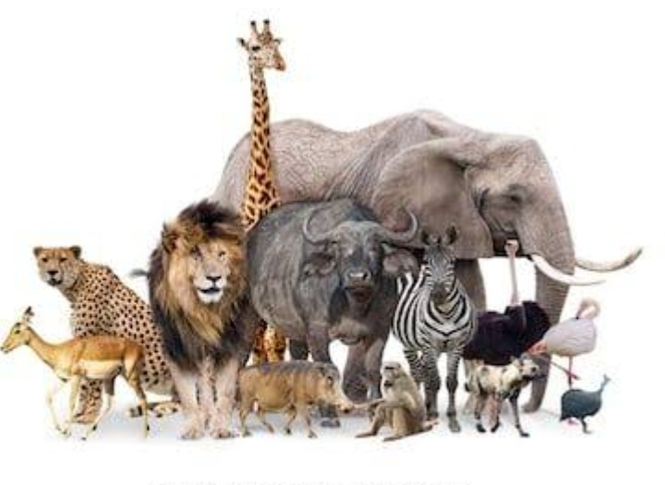
POEM: ANIMAL BY WALT WHITMAN

Slide 3
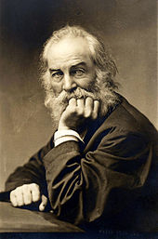
POET: WALT WHITMAN (AMERICAN POET)
1819-1892

Slide 4
Introduction of Walt Whitman
American – Influential Writer
Poet, Essayist & Journalist
Humanist
Transition Poet

Slide 5
Famous Poems
O Captain! My Captain!
O Me! O Life!
Out of the Cradle Endlessly Rocking
I Hear America Singing
Out of Rolling Ocean the Crowd

Slide 6
Key Ideas of the Poem
Animals Are Far Better Than Human Beings
Human Beings Are Greedy And Jealous
Animals Are Calm And Composed
They Are Self-controlled
Own Virtues

Slide 7
Animals
I think I could turn and live with animals, they are
so placid and self-contain’d
I stand and look at them long and long.
They do not sweat and whine about their condition,
They do not lie awake in the dark and weep for their sins,
They do not make me sick discussing their duty to God,
Not one is dissatisfied, not one is demented with
the mania of owning things,
Not one kneels to another, nor to his kind that
lived thousands of years ago,

Slide 8
Not one is respectable or unhappy over the whole earth.
So they show their relations to me and I accept them.
They bring me tokens of myself, they evince
Them plainly in their possession
I wonder where they get those tokens,
Did I pass that way huge times ago and negligently drop them?
Walt Whitman
(From ‘Song of Myself’ in Leaves of Grass)

Slide 9
Explanation of the Poem
Poet’s Wish: To Turn To Animals & To Join The Company Of Animals
Animals Possess Virtues Like Peacefulness And Self-restraint
Greed For Worldly Possessions And Achievements
Fascinated By Their Self-contained Nature
Content In Their Own Lives

Slide 10
Humans Have Despair And Despondency
Animals Do Not Cry Out For The Things They Lose
Animals Do Not Get Involved In Misdeeds
They Have No Regret For Anything.

Slide 11
No Boastful Talk
No Duty To The Almighty
No Purpose Of Wining Other People’s Applause And Popularity
Animals Are Never Dissatisfied Like Humans
Contented With Whatever They Have

Slide 12
No Hierarchy In the World Of Animal
One Inferior Nor Is Any One Superior.
No One More Important Or Insignificant
No One More Important Or Insignificant
They Practice The Principle Of Equality
Never Extremely Happy Or Sad

Slide 13
They Are Honest In Exhibiting Their Relations To Other Animals
Walt Whitman Takes To Contemplation
Got All Those Wonderful Qualities
Lost Those Qualities
Human Beings Did Possess Those Qualities Viz. Truthfulness, Innocence, Kindness etc.
They Turned Over To The Animals

Slide 14
FIGURES OF SPEECH
Repetition: Repetition of words/phrases/line(s) in the poem is called Repetition.
Examples:
1. I stand and look at them long and long 2. They do not………… 3. Not one is………
Alliteration: It is the repetition of a consonant sound at the beginning of words in the same line.
Examples:
I wonder where they get those tokens.

Slide 15
Personification: It is a figure of speech wherein non-living things are assigned humanly qualities. Almost every line has personification in the poem.
Examples:
They do not….. sweat and whine …
They do not.. lie awake…….
..they are so placid and self-contain’d.

Slide 16
THANK YOU

